Slide 1

Participation-Contributed Temporal Dynamic Model for Group Activity Recognition
Rui Yan, Jinhui Tang, Xiangbo Shu, Zechao Li, Qi Tian
Prepared by Rui Yan
Email: ruiyan@njust.edu.cn
PhD Student @ Nanjing University of Science and Technology

Slide 2
Outline
Background
The Categories of Human Activity
The Definition of Group Activity Recognition
The Pipeline for Group Activity Recognition
Motivation
Proposed Method
Framework of the PC-TDM
Capturing Long Motion with Optical Flow
Capturing Flash Motion with Attention Mechanism
Aggregating Individuals’ Latent Representation
Experiments
Conclusion

Slide 3
Background

Slide 4
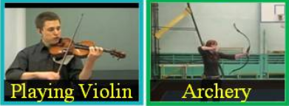
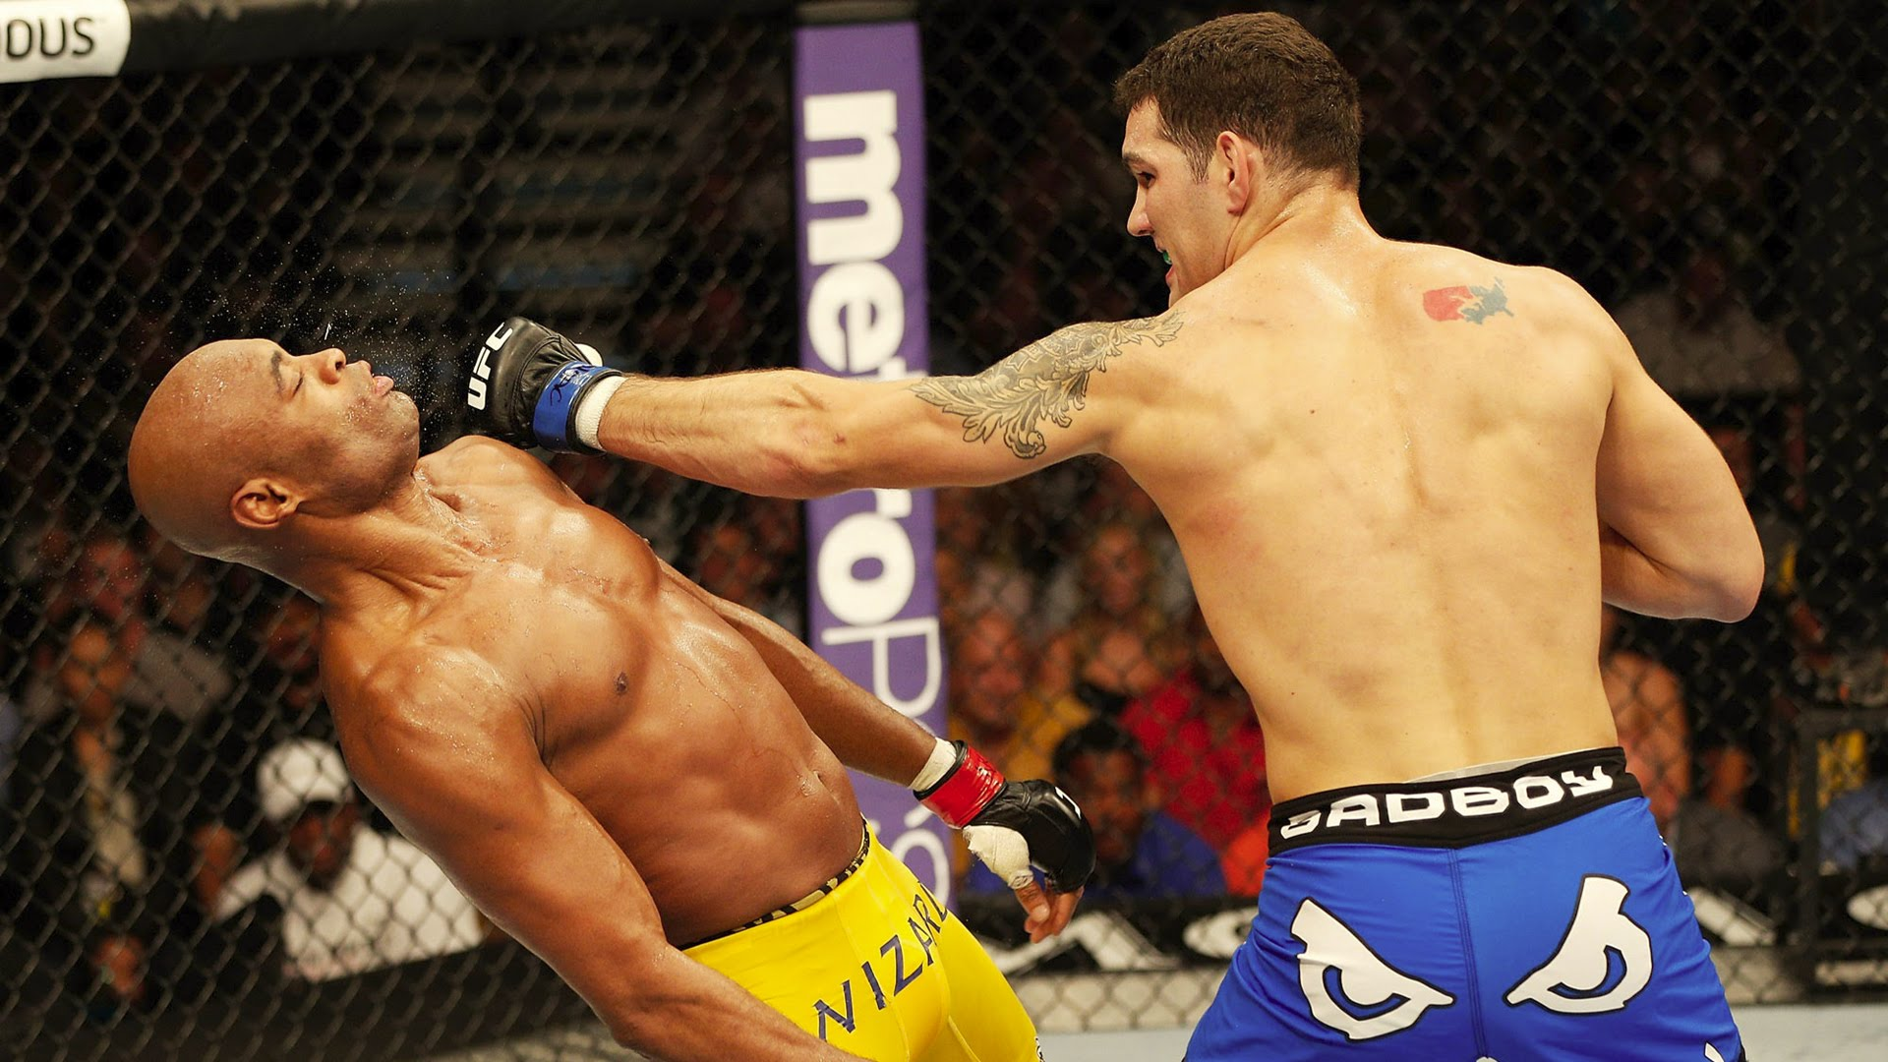
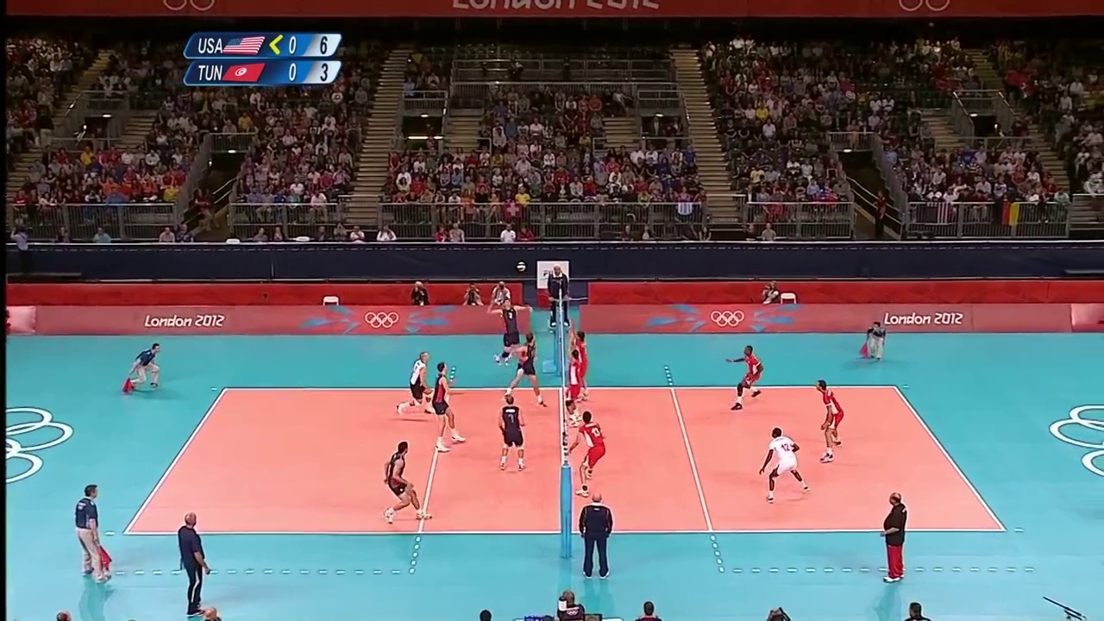
The Categories of Human Activity
Human activities can be classified into the following three categories:
Single-action (e.g., UCF101)
Interaction
Group Activity
Notes:
（40s）There are various types of human activities. According to the number of participants and their complexity, human activities can be classified into the following three categories: single-action, interaction, and group activity. Single-action is the human activity that performed by single person, such as the action in UCF dataset. Interaction is the human activity that involve two persons, such as ‘boxing’. Finally, group activity performed by multiple persons, often depicts a more complex scene involving single action and various interactions, such as the volleyball game.

Slide 5
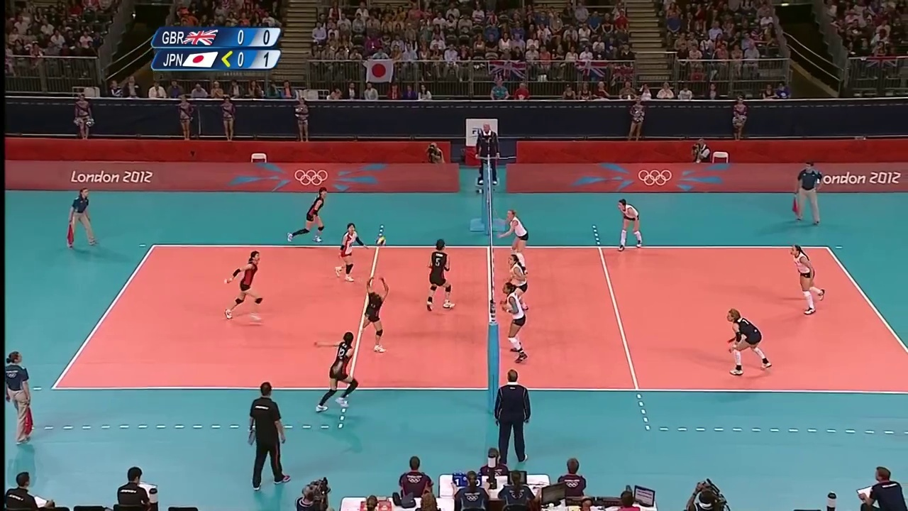

The Definition of Group Activity Recognition
Activity = “Left Set”
Moving
Standing
Standing
Standing
Standing
Standing
Standing
Standing
Moving
Setting
Standing
Moving
Group Activity = $f$(a number of Human Actions)
Notes:
(30s) Here, we focus on the recognition of group activity and give a simple definition of this task. The dataset of group activity usually has 2-levels annotation (people annotation, called action and scene annotation, called activity). The target for this task is to find a generalized function $f$ for modeling a number of human actions, to recognize the activity.

Slide 6
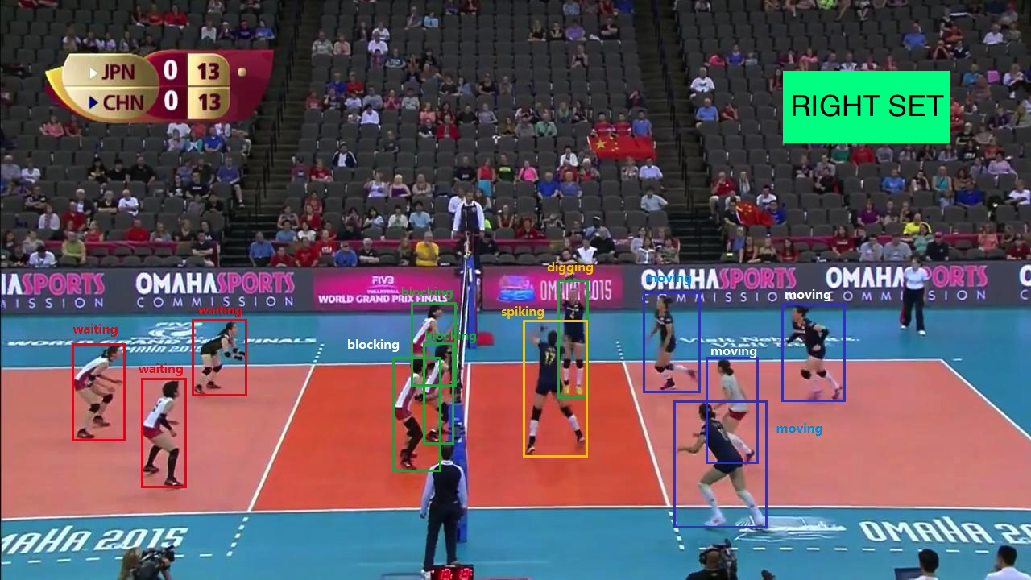
The Pipeline for Group Activity Recognition
CNN + RNN based Temporal Model
Learning Individuals’ Representations
Ibrahim et al. CVPR 2016
Li et al. ICCV 2017
Shu et al. CVPR 2017
Wang et al. CVPR 2017
Graphical Model
Aggregating Them into Group Representations
Deng et al. BMVC 2015
Lan et al. NIPS 2010
Deng et al. CVPR 2016
RNN based Hierarchical Model
Inferring the Label of Group Activity
Ibrahim et al. CVPR 2016
Wang et al. CVPR 2017
Notes:
(total 60s) Generally, existing solutions for group activity recognition can be summarized as two key steps: First) Learning Individuals’ Representations; Second) Aggregating Them into Group Representations and inferring the class label.
In the first step, some works are proposed to learn temporal feature with CNN and RNN for better understanding individuals’ action.
In the second step, some recent methods attempt to encode the high order relationship among persons in the scene by graphical structures or RNN. However, most of these works ignore such inherent characteristic of group activity that not all individuals’ actions contribute to group activity equivalently.

Slide 7

Motivation
Who are the key actors?
Maintain steady motions during the whole process.
Display remarkable motions at a certain moment.
Notes:
(45s) Previous research has shown that some persons are irrelevant to the whole group activity. That is to say, only a small number of key actors play important roles in activity. Therefore, the fundamental problem becomes: Who are the key actors? Through investigation and study, we find that key actors should maintain steady motions during the whole process or display remarkable motions at a certain moment. To explain this better, we give an example.

Slide 8
Motivation
“Left set”
Notes:
(30s) In the “left set” scene of volleyball game, person A moves across the court and participates in the activity during the whole process. The curve is plotted to show Person A’s motion intensity varying with the time. The value of motion intensity for a certain time is calculated by their optical flows between two consecutive frames. In our opinion, this type of motion which has continued for a long time, is more related to the activity.

Slide 9
Motivation
“Left set”
Notes:
(30s) Moreover, person B hit the ball only in a short moment, but will decide the inference to group activity. The curve plotted for Person B has a spike at last several moments, that the model should focus on.

Slide 10
Motivation
“Left set”
Notes:
(30s) In this paper, the above motions are called long motion and flash motion, respectively. Both types of key actors can provide crucial clues to understand the activity “left set”.

Slide 11
Proposed Method

Slide 12
Framework of the PC-TDM
Capturing Long Motion
Capturing Flash Motion
Aggregating Individuals’ Representation
Notes:
(45s) The framework can be divided into two parts: First, the “One” Network responds to learn the temporal representation for each person by feeding their spatial CNN features into Single-Person LSTM. Second, the “One to Key” Network consisting of two LSTM layers, is designed to model their interactions and aggregate these personal representation with attending to key actors.
Specifically, we feed the dynamics of each person into the Interaction Bi-LSTM by their value of long motion in descending order.
For Long motion, ……
Then we integrate all hidden states from Interaction Bi-LSTM with the time-varying attention weights by an Aggregation LSTM.
The attention mechanism is empolyed to capture Flash motion.
For aggregating individuals’ representation, ……
Finally, we average softmax scores from each time step as the final prediction for the group activity recognition.

Slide 13

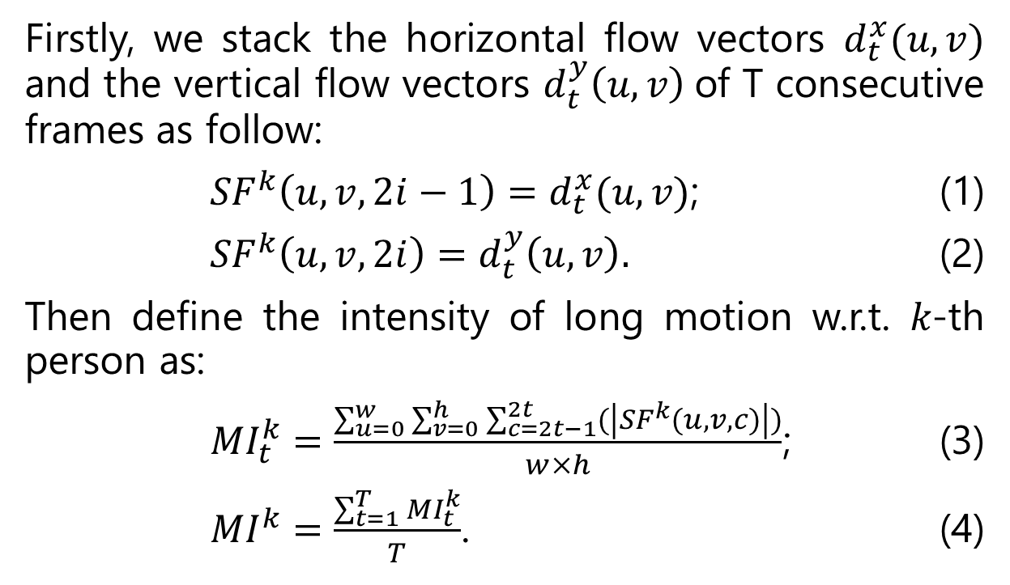
Capturing Long Motion with Optical Flow
Firstly, we stack the horizontal flow vectors $d_{t}^{x}(u,v)$ and the vertical flow vectors $d_{t}^{y}\left(u,v\right)$of T consecutive frames as follow:
${SF}^{k}\left(u,v,2i−1\right)=d_{t}^{x}(u,v)$; (1)
${SF}^{k}\left(u,v,2i\right)=d_{t}^{y}\left(u,v\right).$ (2)
Then define the intensity of long motion w.r.t. 𝑘-th person as:
${MI}_{t}^{k}=\frac{\sum_{u=0}^{w}{\sum_{v=0}^{h}{\sum_{c=2t−1}^{2t}{(\left|{SF}^{k}(u,v,c)\right|)}}}}{w×h}$; (3)
${MI}^{k}=\frac{\sum_{t=1}^{T}{{MI}_{t}^{k}}}{T}$. (4)
Notes:
(40s) We stack the horizontal and vertical flow vectors $d_{t}^{y}\left(u,v\right)$of T consecutive frames as equation (1-2).
The motion intensity of k-th person at time step t is defined as equation 3, and the motion intensity of k-th person throughout the whole process is defined as equation 4. Obviously, if the motion intensity of one person is large, it is indicated that this person participates in the activity frequently over time.

Slide 14
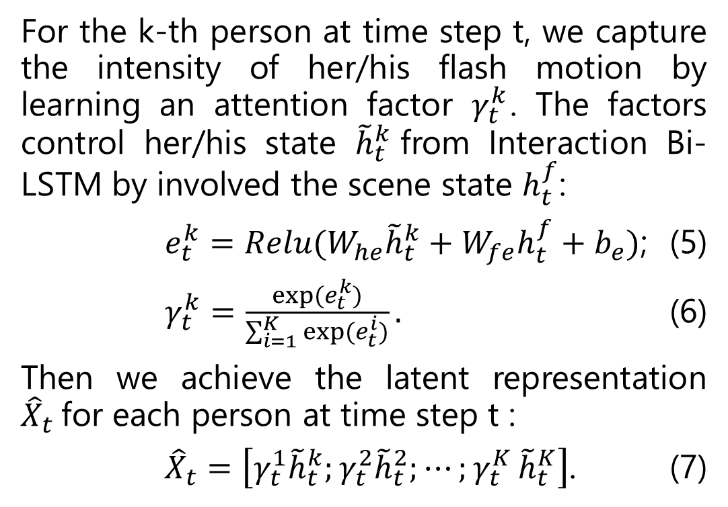
Capturing Flash Motion with Attention Mechanism
For the k-th person at time step t, we capture the intensity of her/his flash motion by learning an attention factor $γ_{t}^{k}$. The factors control her/his state ${\tilde{h}}_{t}^{k}$from Interaction Bi-LSTM by involved the scene state $h_{t}^{f}$:
$e_{t}^{k}=Relu(W_{he}{\tilde{h}}_{t}^{k}+W_{fe}h_{t}^{f}+b_{e})$; (5)
$γ_{t}^{k}=\frac{exp⁡(e_{t}^{k})}{\sum_{i=1}^{K}{exp⁡(e_{t}^{i})}}.$ (6)
Then we achieve the latent representation ${\hat{X}}_{t}$for each person at time step t :
${\hat{X}}_{t}=\left[γ_{t}^{1}{\tilde{h}}_{t}^{k};γ_{t}^{2}{\tilde{h}}_{t}^{2};⋯{;γ}_{t}^{K}{\tilde{h}}_{t}^{K}\right]$. (7)
Notes:
(40s) For each person, we capture the intensity of flash motion by learning an attention factor $γ_{t}^{k}$ to control the state output from Interaction Bi-LSTM by involved the scene state $h_{t}^{f}$. Here, if the personal action is more related to the group activity, the corresponding attention factor will be larger, and vice versa.

Slide 15
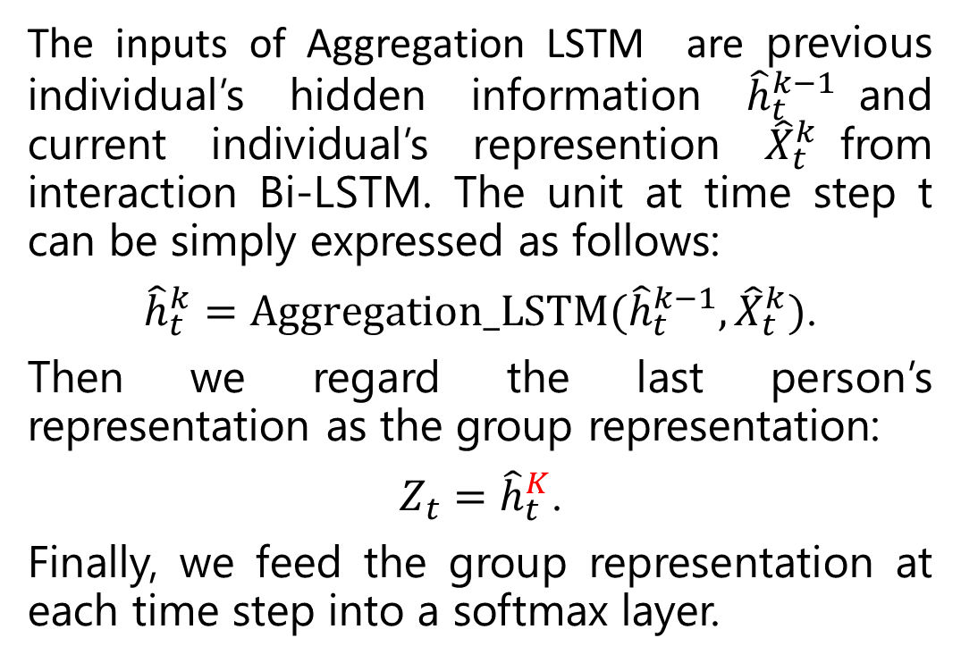
Aggregating Individuals’ Latent Representation
The inputs of Aggregation LSTM are previous individual’s hidden information ${\hat{h}}_{t}^{k−1}$and current individual’s represention ${\hat{X}}_{t}^{k}$from interaction Bi-LSTM. The unit at time step t can be simply expressed as follows:
${\hat{h}}_{t}^{k}=Aggregation_LSTM({\hat{h}}_{t}^{k−1},{\hat{X}}_{t}^{k})$.
Then we regard the last person’s representation as the group representation:
$Z_{t}={\hat{h}}_{t}^{K}$.
Finally, we feed the group representation at each time step into a softmax layer.
Aggregation LSTM (in black)
Notes:
(30s) The inputs of Aggregation LSTM are the previous individual’s hidden information and current individual’s representation from interaction Bi-LSTM.
In volleyball dataset, we concatenate the last aggregated states of two sides as an input of a softmax layer at each time step.

Slide 16
Experiments

Slide 17
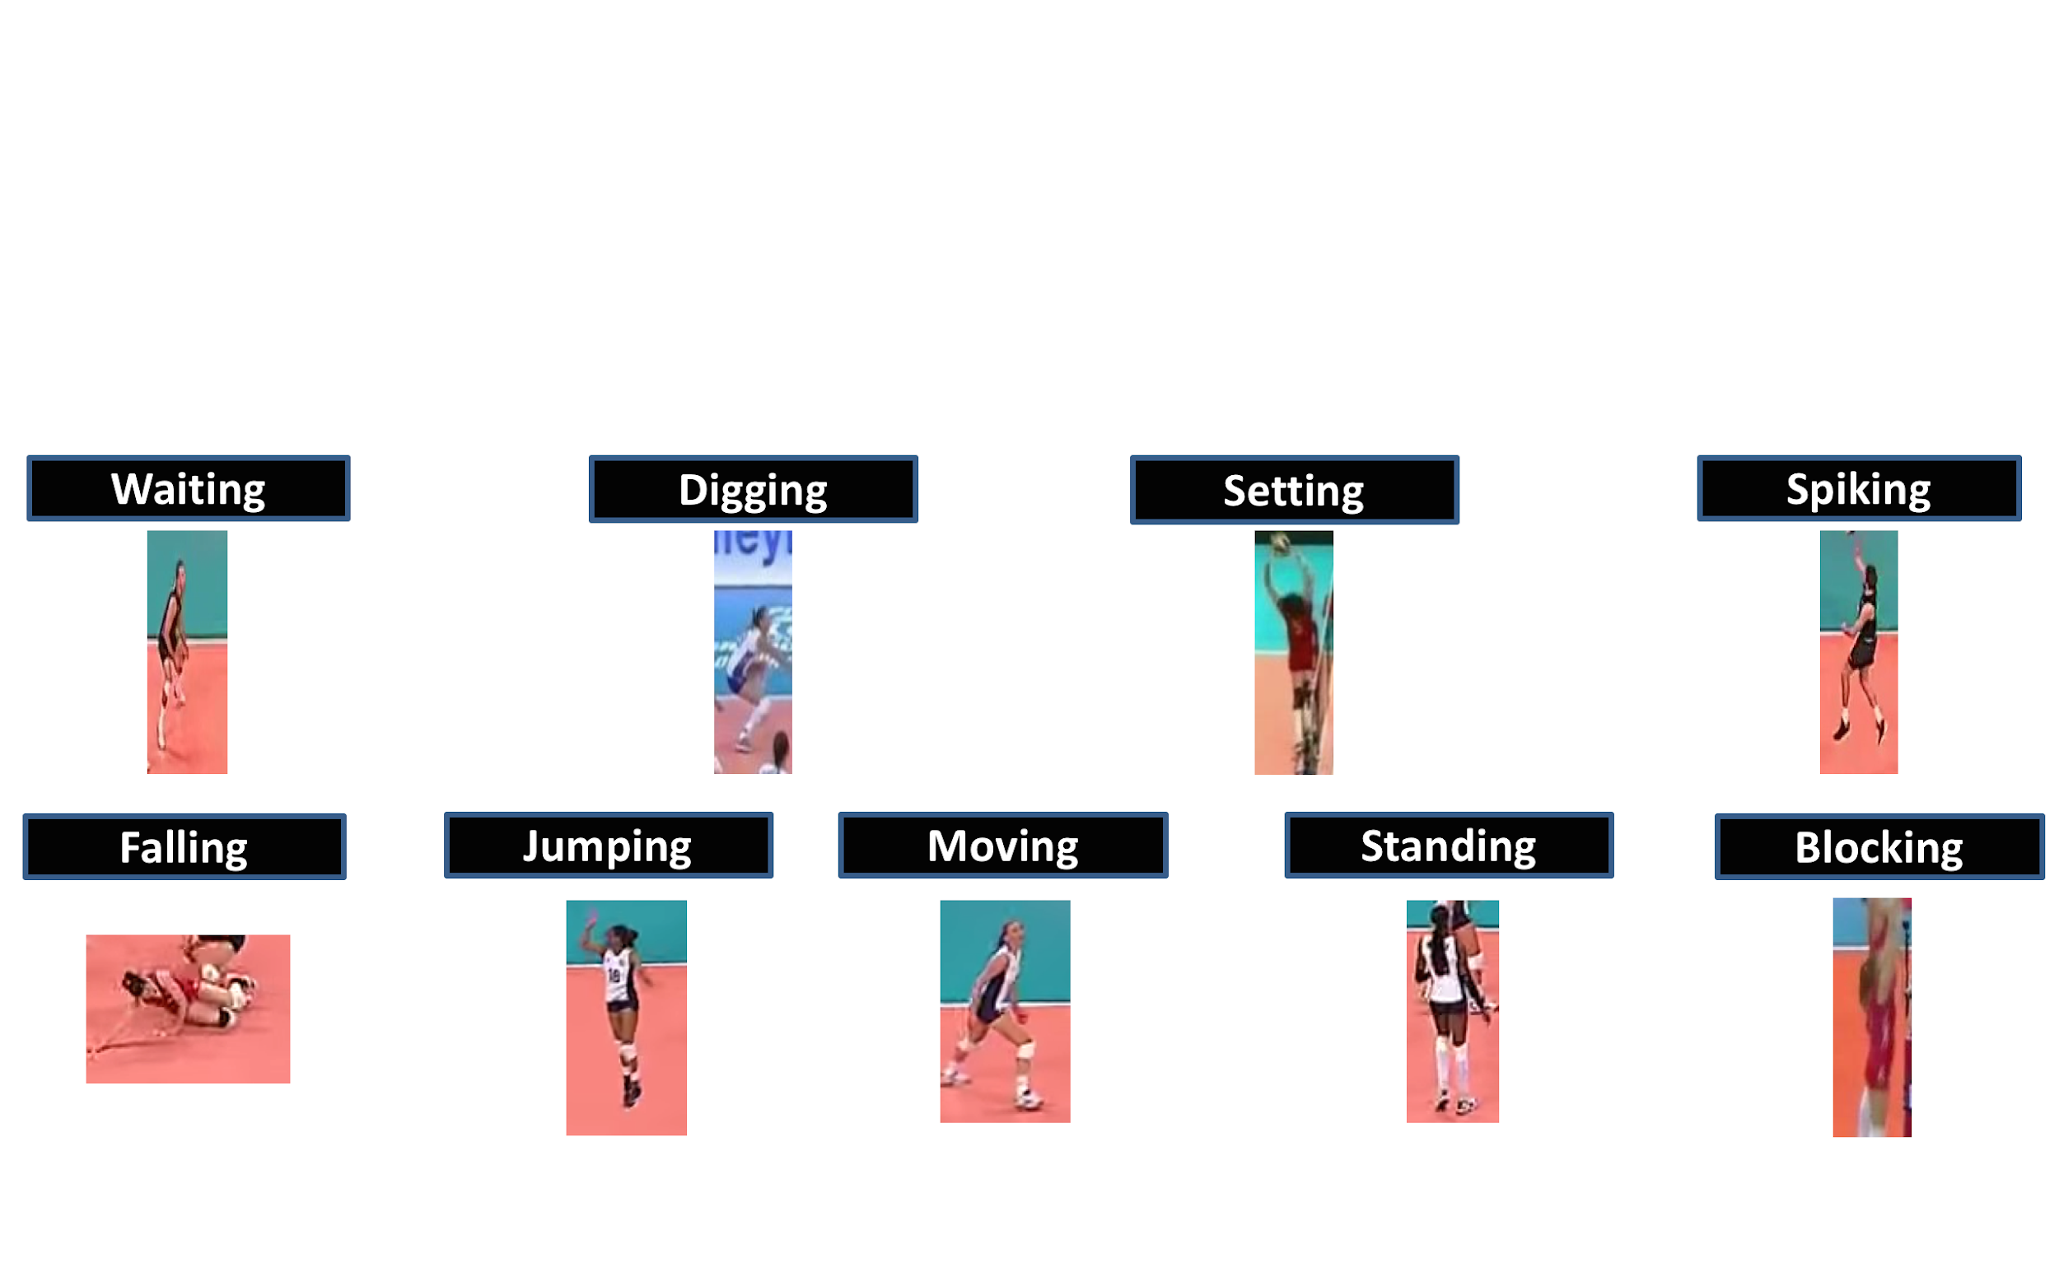
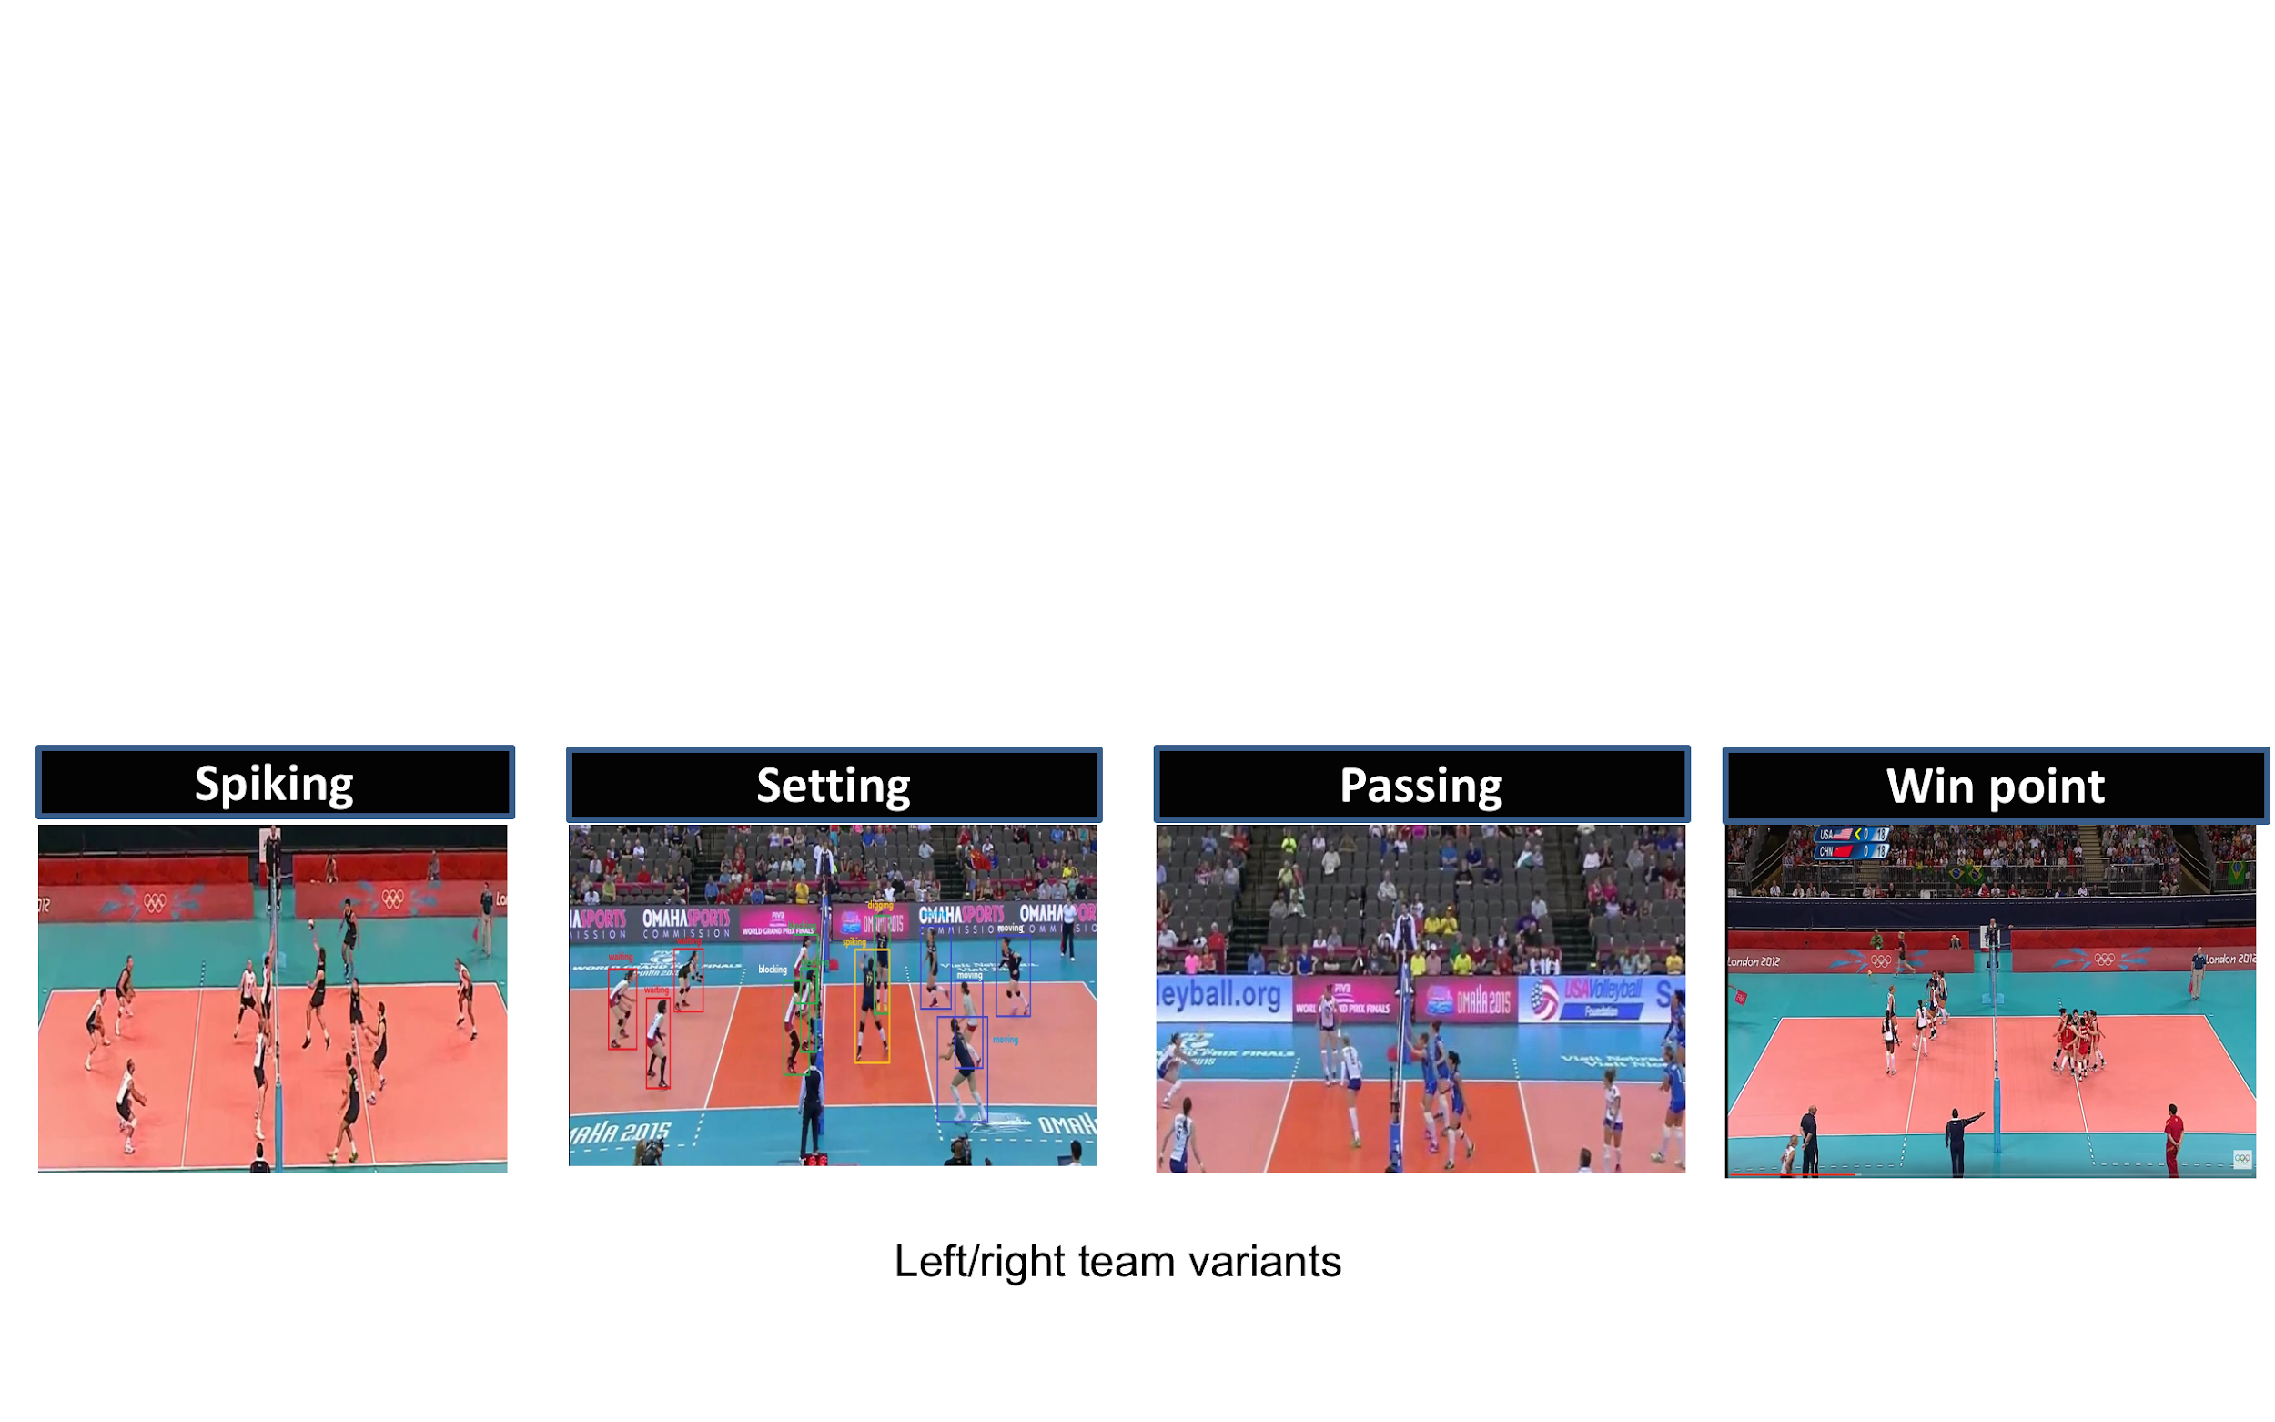
Datasets: Volleyball Dataset (VD)
4830 annotated frames from 55 YouTube videos.
9 action labels (person level), and 8 activity labels (group level).
(a) Action labels
(b) Activity labels (left/right team variants)
Moustafa Ibrahim et al. 2016. A Hierarchical Deep Temporal Model for Group Activity Recognition. In CVPR.
Notes:
(30s)Volleyball Dataset is a new sport dataset collected from publicly available YouTube volleyball videos, consists of 55 videos. For one frame, the location of each player is given and labeled with one of the action (such as “Waiting”, “Setting”, “Jumping”, “Moving”), and one of the group activity (such as “Spiking”, “Passing”, “Setting”, “Win point”) is labeled to this frame.

Slide 18
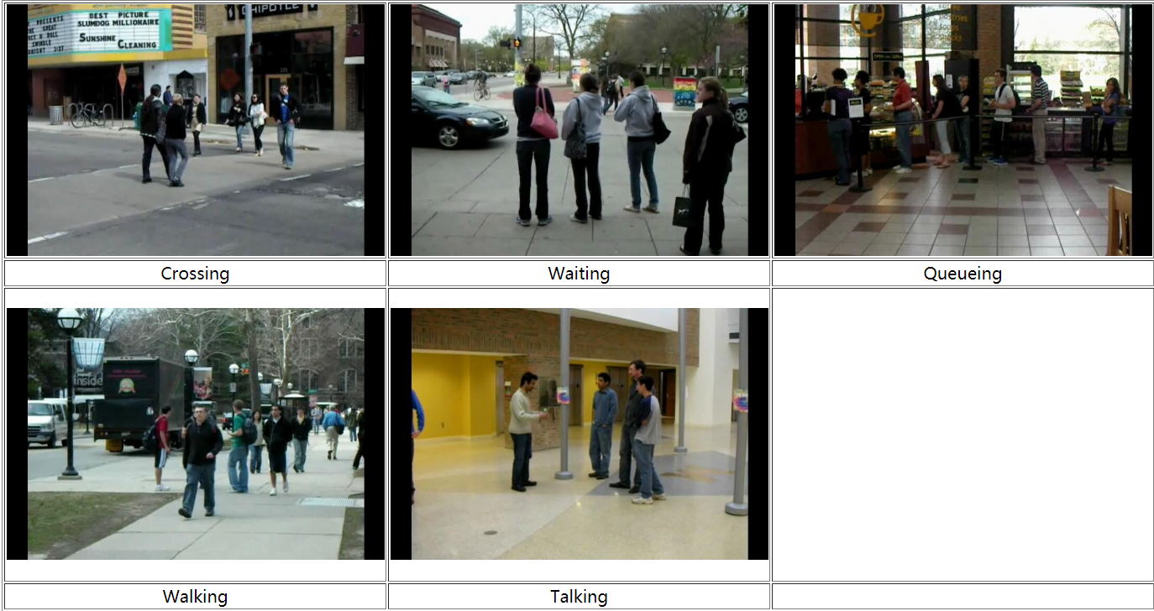





Datasets: Collective Activity Dataset (CAD)
44 video clips collected by a low resolution hand-held camera.
5 action labels (person level), and 5 activity labels (group level).
Crossing
Waiting
Queueing
Walking
Talking
(a) Action labels
(b) Activity labels
Wongun Choi et al. 2009. What are they doing? : Collective activity classification using spatio-temporal relationship among people. In ICCV Workshops.
Notes:
(30s) Collective Activity Dataset contains 44 video clips collected by a low resolution hand-held camera. Each person labeled from five action labels. Each frame is assigned with the label of group activity based on what the majority of people are doing in the scene.
Following the experimental setting in CVPR [39], we merge class “Walking” and “Crossing” as “Moving” and report the Mean Per Class Accuracy (MPCA) due to the imbalanced test set.

Slide 19
Experiment Settings
B1 Single Person Classification: Max-pooling over all persons’ spatial features for each frame;
B2 PC-TDM without OKN: Max-pooling over all persons’ spatio-temporal features for each frame, similar to [Ibrahim et al. CVPR 2016];
B3 PC-TDM without Long Motion: Ordering the personal features by roughly using spatial positions of all persons (i.e., from left to right in a frame);
B4 PC-TDM without Flash Motion: Max-pooling the hidden states output from Interaction Bi-LSTM into a single representation for each frame.
Dataset | No. Groups | No. Single-person LSTM Nodes (time steps) | No. Interaction Bi-LSTM Nodes (time steps) | No. Aggregation LSTM Nodes(time steps)
VD | 2 | 3000 (10) | 1000 (6) | 1000 (6)
CAD | 1 | 3000 (10) | 1000 (5) | 1000 (5)
Performance metrics: Multiclass Classification Accuracy (MCA), Mean Per-Class Accuracy (MPCA).
Notes:
We design four baselines, in which B2, B3 and B4 are used for ablation study to verify the effectiveness of OKN, Long motion and Flash motion, respectively.
The configurations of three types of LSTM are listed in the table. In the VD dataset, players are need to be divided into two groups, representing two teams. There is no need for CAD dataset.
The performance metrics are Multiclass Classification Accuracy (MCA) and Mean Per-Class Accuracy (MPCA).

Slide 20
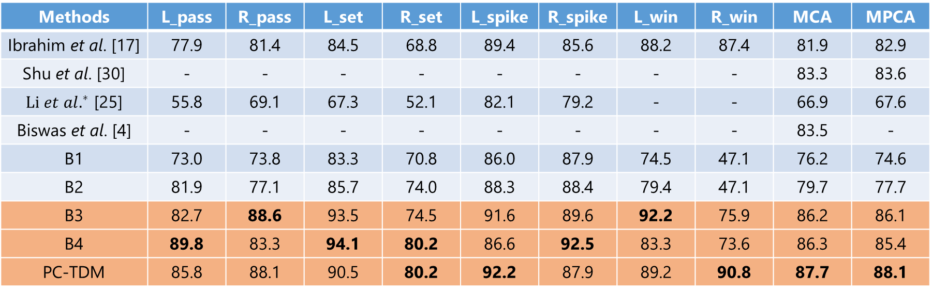
Results on Volleyball Dataset
Methods | L_pass | R_pass | L_set | R_set | L_spike | R_spike | L_win | R_win | MCA | MPCA
Ibrahim et al. [17] | 77.9 | 81.4 | 84.5 | 68.8 | 89.4 | 85.6 | 88.2 | 87.4 | 81.9 | 82.9
Shu et al. [30] | - | - | - | - | - | - | - | - | 83.3 | 83.6
 | 55.8 | 69.1 | 67.3 | 52.1 | 82.1 | 79.2 | - | - | 66.9 | 67.6
Biswas et al. [4] | - | - | - | - | - | - | - | - | 83.5 | -
B1 | 73.0 | 73.8 | 83.3 | 70.8 | 86.0 | 87.9 | 74.5 | 47.1 | 76.2 | 74.6
B2 | 81.9 | 77.1 | 85.7 | 74.0 | 88.3 | 88.4 | 79.4 | 47.1 | 79.7 | 77.7
B3 | 82.7 | 88.6 | 93.5 | 74.5 | 91.6 | 89.6 | 92.2 | 75.9 | 86.2 | 86.1
B4 | 89.8 | 83.3 | 94.1 | 80.2 | 86.6 | 92.5 | 83.3 | 73.6 | 86.3 | 85.4
PC-TDM | 85.8 | 88.1 | 90.5 | 80.2 | 92.2 | 87.9 | 89.2 | 90.8 | 87.7 | 88.1
Table 1: Comparison of different methods on Volleyball Dataset.
Notes:
(30s) There are only a little of works referring to Volleyball Dataset, Shu and Li did not provide specific accuracy of per-class or the MPCA. The comparison results are shown in Table 1. We can see that the PC-TDM achieves the best performance on MCA and MPCA. Our model improves 5.8% and 5.2% compared with the most related work [17] on MCA and MPCA, respectively. And improves 4.4% (four point four percent) and 4.5% compared with the existing state-of-the-art performance in [30] on MCA and MPCA, respectively. And, more remarkable, all of the best accuracy for each class occurs in our model or its variants, highlighted in orange.

Slide 21
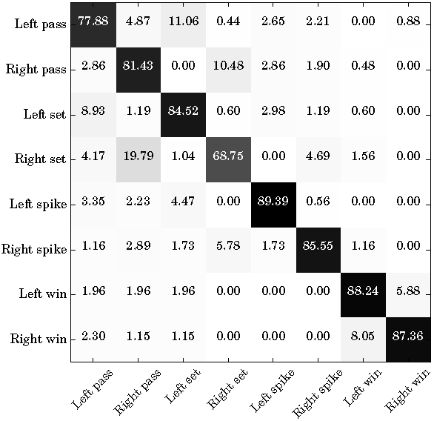
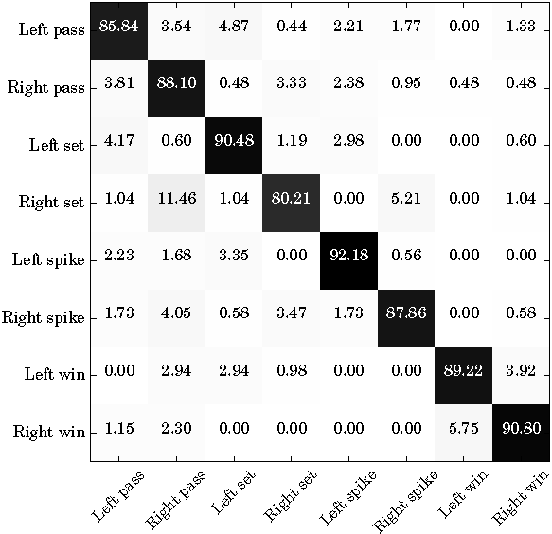
Results on Volleyball Dataset
Ibrahim et al. CVPR 2016
Ours
Figure 1: Confusion matrixs on Volleyball Dataset
Notes:
(30s) The confusion matrix of PCTDM is also shown in Figure 1. Compared to the work in CVPR, the proposed PC-TDM overcomes the confusion between class “Set” and “Pass” well. From this experiment, we validate the effectiveness of key actors with long motion or flash motion for recognizing group activity.

Slide 22
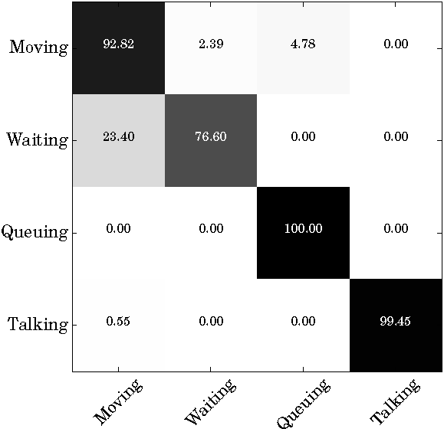
Results on Collective Activity Dataset
Methods | Moving | Waiting | Queuing | Talking | MPCA
Lan et al. [24] | 92 | 69 | 76 | 99 | 84
Choi et al. [6] | 90 | 82.9 | 95.4 | 94.9 | 90.8
Zhou et al. [43] | 88.5 | 74.0 | 95.0 | 98.0 | 88.9
Ibrahim et al. [17] | 95.9 | 66.4 | 96.8 | 99.5 | 89.7
Hajimirsadeghi et al. [13] | 87.0 | 75.0 | 92.0 | 99.0 | 88.3
Wang et al. [39] | 94.9 | 63.6 | 100 | 99.5 | 89.4
Li et al. [25] | 90.8 | 81.4 | 99.2 | 84.6 | 89.0
B1 | 97.6 | 51.8 | 100 | 99.5 | 87.2
B2 | 99.5 | 48.2 | 100 | 99.5 | 86.8
B3 | 92.3 | 73.1 | 100 | 99.5 | 91.2
B4 | 88.0 | 79.4 | 100 | 99.5 | 91.7
PC-TDM | 92.8 | 76.6 | 100 | 99.5 | 92.2
Figure 2: Confusion matrix on Collective Activity Dataset
Table 1: Comparison of different methods on Collective Activity Dataset. Mean Per-Class Accuracy (MPCA)
Notes:
(30s) In addition, we also conducted experiment on Collective Activity Dataset. We only report MPCA due to the imbalanced test set.
We can see that the proposed PC-TDM achieves the best performance, and its MPCA improves 1.4% compared with existing state-of-the-art performance in [6].
As new exploration by focusing on actions of key participants, PC-TDM improves 2.5% compared with the most related work [17] on MPCA.

Slide 23
Conclusion

Slide 24
Conclusion
The PC-TDM hierarchically learns discriminative representation for group activity with attending to key participants.
The “One to Key” Network (OKN) can progressively aggregate the dynamics of key participants with different long motions or flash motions one-by-one, while automatically avoiding the irrelevant motions.

Slide 25


Thank you for your attention !
Homepage: https://ruiyan1995.github.io/

